Slide 1
Benefits Open Enrollment Review

Slide 2
Open Enrollment Overview
What’s coming in 2026
My Benefits Life
Vanguard New 401(k) Recordkeeper
Medical Benefits Overview
Plan Design
Carrier/Vendor Overview
Wellness
SupportLinc EAP and Wellness Program Personify Health

Slide 3

Open Enrollment
Annual Enrollment will be November 1-15
Passive Enrollment - No action required, with exception of Flexible Savings Accounts (FSA)
New My Benefits Life Site
Plan Updates
Changes to medical plan co-pays, and deductibles refer to benefits guides
Spectrum HSA contributions $500 for individuals / $1,000 for family coverage
Employee medical contributions increase between $8.06 - $56.72 per month depending on plan and coverage tier
Increased vision benefit for frame allowance from $175 to $200
Dependent Care FSA allowance increasing from $5,000 per year to $7,500 per year
New! Life/Disability/FMLA Carrier Change
Effective 1/1/26 moving from Reliance Matrix to New York Life
Voluntary benefits moving from Voya to New York Life
New! Program Update
Moving tobacco cessation program from Quit4Life to UBreathe, administered by CuraLinc
No Changes To
Medical, Dental, and Vision provider networks
Dental and Vision benefits and premiums

Slide 4



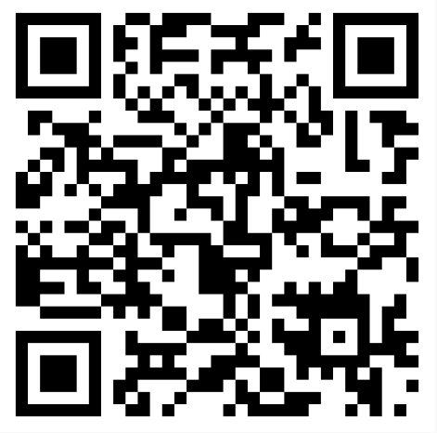

My Benefits Life
One Stop for Benefits
At work, at home, or on the go, get information about Spectrum Brand’s employee benefits 24/7.
Introducing MyBenefits.Life®
BENEFITS DETAILS ANYTIME, ANYWHERE
Understanding your benefits has never been easier
What you’ll find
Plan Details
What’s covered
Enrollment
When and how to sign up
Easy Access
No username or password is needed, and the site automatically adjusts to your screen on a computer or mobile device.
Contact Information
Get help with your benefits
Scan QR code to go to site.
AVAILABLE 24/7 ANYWHERE YOU HAVE INTERNET ACCESS
Home - Spectrum Brands

Slide 5

Vanguard 401(k)
Moving from Empower to Vanguard effective 11/1/2025
All regular employees are eligible to join the plan upon hire
Vesting remains the same: 100% immediately vested
Matches remain the same:
Union: 100% on the first 3% you contribute
Non-Union: 100% on the first 3% you contribute, plus 50% of the next 2% you contribute
Special Services
Automatic account rebalancing based on investment elections and personal investment assistance from a licensed investment counselor
Visit Vanguard at vanguard.com/retirementplans to manage your account, investments and contributions

Slide 6
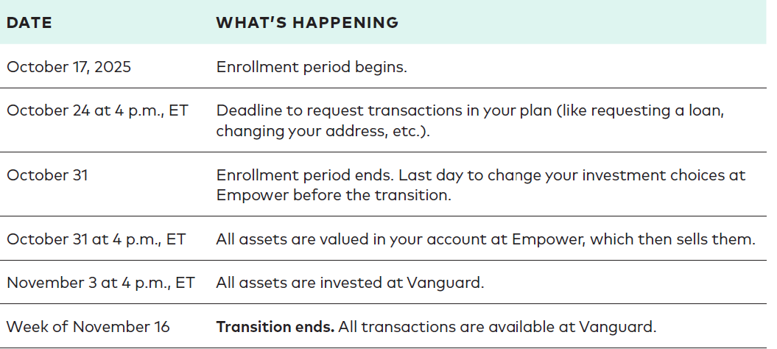
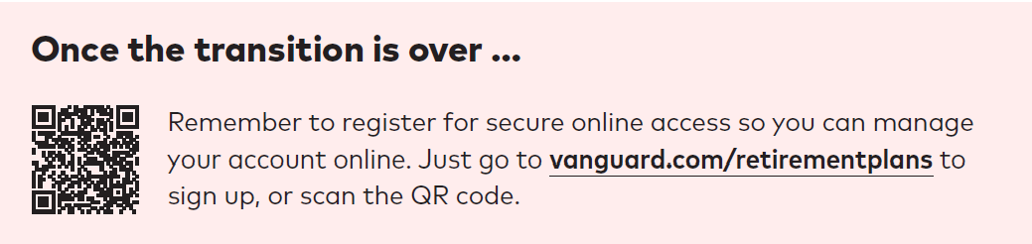
Vanguard Transition Key Dates

Slide 7
Medical Plan Updates
Small increases to deductibles and out of pocket maximums
First increase in 3 years
Employer HSA contribution change
$1,000 family
$500 single
HSA contribution limits increased for 2026 (Gold HSA Plan)
$4,400 individual / $8,750 for family
FSA contribution limits increased for 2026
Health Care FSA (PPO plans) $3,400 max
Limited Purpose FSA (HSA Plan) $3,400 max
Dependent Care FSA $7,500

Slide 8
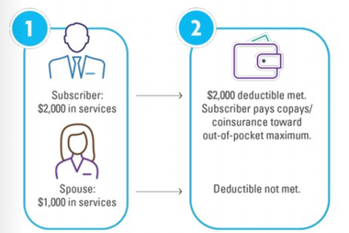
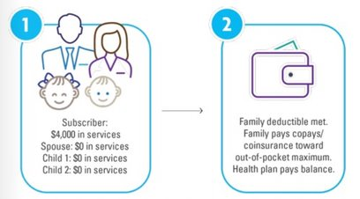
Deductibles
What is a deductible?
A deductible is the amount you pay first before your insurance starts covering services.
For example: Under the HSA plan, if your deductible is $1,700, you pay 100% of costs until you've spent $1,700.
Depending on which plan you are enrolled in, you may have embedded or aggregate deductibles.
Embedded Deductible (Silver & Gold PPO plan) | Aggregate Deductible (Gold HSA plan)
There are 2 deductible amounts within one plan; single & family. No one family member can contribute more than the single amount toward the family deductible. Example: You have a $1,000/$3,000 (single/family) embedded deductible. Here is how your plan would work. | A family can meet the deductible by pooling all members expenses. Example: You have a $5,000 family deductible. Here is how your plan would work:
Notes:
Let’s talk about deductibles for a minute. When you’re enrolled in a medical plan, you’re subject to a deductible. The deductible is the amount of healthcare expenses you are responsible for before your health plan will pay. Generally, copayments do not apply to your deductible, but most other medical expenses do. The deductible does not apply to preventive care and certain other services. Family coverage may have an embedded or aggregate deductible. An embedded deductible means the plan begins to pay for an individual member as soon as they reach their individual deductible. Aggregate means your family must meet the entire family deductible before any individual expenses are covered.

Slide 9
Deductibles: Embedded or Aggregate?
Gold PPO Plan
Subject to an embedded $3,000 family deductible with $1,000 individual deductibles. This means that once one of them meets their $1,000 individual deductible, they only pay 20% coinsurance until they meet the $3,000 individual out-of-pocket maximum.
Gold HSA Plan
Subject to an aggregate $5,000 family deductible. This means that all of their expenses must add up to $5,000 in order to satisfy the deductible. Once one or all of them meet the $5,000 family deductible, then they pay 20% coinsurance until they meet the $6,800 family out-of-pocket maximum.
Example: Let’s assume that Michael needs a procedure that costs $5,000.
If Michael and his family were enrolled in the Gold PPO plan, Michael would pay his individual deductible of $1,000 and then coinsurance until he reaches the OOP Max. The family would not satisfy the $3,000 family deductible until they had met a combination of $3,000 in total deductible expenses.
If Michael and his family were enrolled in the Gold HSA plan, Michael would pay the full $5,000 family deductible. After that procedure, any other medical or prescription drug expenses incurred by Michael or his family members would only be subject to coinsurance until they reach the OOP Max.
Notes:
To learn more about embedded vs aggregate deductibles, let’s consider an example:
The Smith family, a family of 4, is trying to decide between electing the Spectrum Brands Gold PPO or Gold HSA plans and aren’t sure about the deductibles. They want to know how much they’re going to have to pay for their procedures, visits, and prescriptions this year.
If the Smiths choose the Gold PPO Plan, they will be subject to an embedded $3,000 family deductible with $1,000 individual deductibles. This means that once one of them meets their $1,000 individual deductible, they only pay 20% coinsurance until they meet the $3,000 individual out-of-pocket maximum.
If the Smiths choose the Gold HSA Plan, they will be subject to an aggregate $5,000 family deductible. This means that all of their expenses must add up to $5,000 in order to satisfy the deductible. Once one or all of them meet the $5,000 family deductible, then they pay 20% coinsurance until they meet the $6,800 family out-of-pocket maximum.

Slide 10
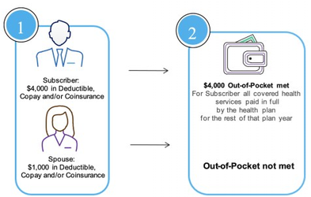
Coinsurance/Out-of-Pocket Maximum
What is coinsurance?
After you have met your deductible, you share costs with your insurance, which is called coinsurance.
For example: 20% coinsurance would mean insurance pays 80% of services while you pay 20%.
Coinsurance and copays continue until you meet your out-of-pocket maximum. Once you hit that maximum, insurance begins paying 100% of all services. All our plans have embedded OOP maximums.
Embedded Out-of-Pocket Maximum (Gold HSA, Silver PPO & Gold PPO plans)
For family plans (2 or more members), there are 2 OOP amounts within the one plan; single & family. The single OOP is embedded in the family OOP, so no one family member can contribute more than the single amount toward the family OOP. Example: You have a $4,000/$8,000 (single/family) embedded OOP, this is how your plan would work:
Notes:
Coinsurance is your share of the cost of a healthcare visit or service that applies after your deductible has been satisfied. Coinsurance is expressed as a percentage and always adds up to 100%. For example, if the plan pays 70%, your coinsurance responsibility is 30% of the cost. If your plan has a deductible, you pay 100% of the cost until you meet your deductible amount, then 30% after.

Slide 11
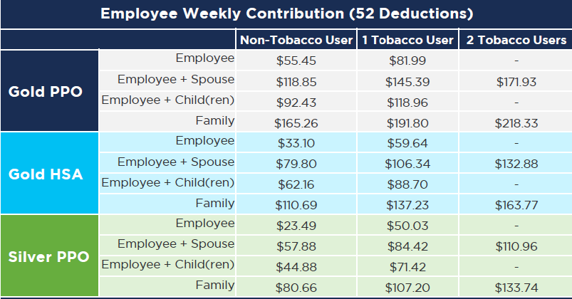
Employee Weekly Medical Contributions

Slide 12
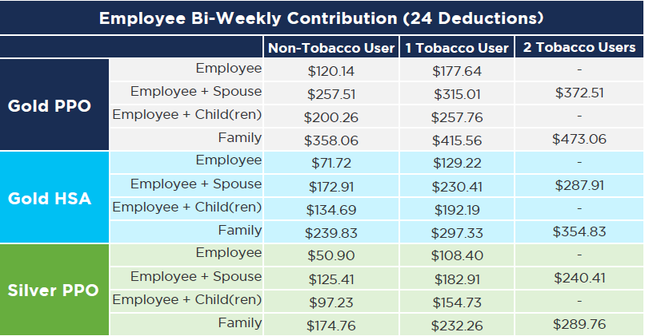
Bi-weekly Employee Medical Contributions

Slide 13

New York Life
New! Life, Disability, & FMLA Carrier Change
Effective 1/1/26 moving from Reliance Matrix to New York Life
Life Insurance
Basic: 1x your annual salary to a maximum of $500,000
Voluntary
Employee: Elect from $10,000 to $500,000 in $10,000 increments. Guaranteed issue of $150,000*.
Spouse: Elect from $5,000 to $500,000 in $5,000 increments. Cannot exceed 100% of the employee’s voluntary life election. Guaranteed issue of $100,000*.
Children: Elect from $10,000 up to $20,000, in $2,000 increments. Guaranteed issue of $10,000.
During Open Enrollment, you may increase your voluntary life insurance coverage up to the Guarantee Issue Amount without completing Evidence of insurability. Going forward, you can increase your voluntary coverage amount by one increment of coverage without providing evidence of insurability up to the guaranteed issue amount during open enrollment only
Short Term Disability: 75% of base wage up to a maximum of $4,500
Long Term Disability
Basic: 50% of your base wage to a maximum of $15,000
Buy-Up: 67% of your base wage up to a maximum of $15,000

Slide 14
New York Life
New! Voluntary Health Benefits Carrier Change
Voluntary benefits moving from Voya to New York Life
Critical Illness
Accident
Hospital Indemnity
Notes:
Effective January 1, Spectrum Brands will move our three Voluntary Benefit plans from VOYA to New York Life
Critical illness insurance can help fill a financial gap if you experience a serious illness such as cancer, heart attack or stroke. Upon diagnosis of a covered illness, a lump-sum, tax-free benefit is immediately paid to you. Use it to help cover medical costs, transportation, childcare, lost income, or any other need following a critical illness.
Accident insurance helps you pay for unexpected costs due to common injuries such as fractures, dislocations, burns, emergency room or urgent care visits, as well as physical therapy. If you or a covered dependent has an accident, this plan pays a lump-sum, tax-free benefit. The amount of money depends on the type and severity of your injury and can be used any way you choose.
Hospital indemnity insurance can enhance your current medical coverage. The plan pays a lump sum, tax-free benefit when you or an enrolled dependent is admitted or confined to the hospital for covered accidents and illnesses. You can use the money you receive under the plan however you see fit - like for paying medical bills, childcare, or for regular living expenses like groceries.
Under the voluntary benefits, you are eligible for a $50 cash benefit if you receive a covered wellness screening during the calendar year. Wellness screenings include things like general health exams, mammography, immunizations, and certain blood tests.

Slide 15

UBreathe Tobacco Cessation
New! Program Update
Effective 1/1/26 moving tobacco cessation program from Quit4Life to UBreathe for employees and spouses.
In order to earn the incentive, employees must begin the program prior to October 1, 2026 and complete the program by November 30, 2026. The UBreathe program consists of six coaching sessions with your dedicated Health Coach.
Administered through our EAP provider
Six coaching sessions with a dedicated Health Coach
You’ll learn the benefits of quitting
Set a “Quit Date” and create a “Quit Plan”
Ongoing support to stay quit and Support in planning for riggers, cravings & withdrawals
Education about nicotine replacement therapies & medications
Upon program completion, the tobacco surcharge is removed from your benefit premium and refunded back to the beginning of the plan year.
To enroll in coaching, call 888.882.5462, or reach out via email at coaching@mywellportal.com.

Slide 16






Wellbeing Benefits
Emotional/Mental
Job Satisfaction
Employee Assistance Program
Bring your dog to work days (Corporate)
Physical
Tuition reimbursement for employees who want to expand skills
Performance rewards
Employee recognition and service awards
Professional development
Hybrid working environment (Corporate)
Medical – LiveHealthOnline, 24/7 Nurseline, Building Healthy Families, Condition Care
Dental & Vision – Programs for people with chronic conditions
Points to earn gift cards up to $325 in gym membership reimbursements and up to $185 for meeting wellness goals
Tobacco cessation
Onsite Flu Shots
Onsite gym (Corporate)
Preventative care covered at 100% in network
Social
Inclusion networks¹ – BEGIN, WIN, PRISM, MAIN
Volunteer time off
Charitable support and local diversity celebrations
Paid holidays
RISE committee – connecting employees (walking clubs, food trucks, chair massages, blood drive)
.
Financial
401(k) retirement plan with employer match
Financial consultation
Discount vendor
Tuition reimbursement
Tax advantaged accounts – HSA and FSA
Life insurance
Disability insurance

Slide 17


Employee Assistance Program (EAP) -SupportLinc
What is an EAP?
Free, confidential benefit from a licensed counselor or coach
Emotional wellbeing resources
Work-life balance support
Available 24/7/365
Who is eligible?
Full-time employees, including those who waive the medical plan
Spouse/Dependents
Household members
How do you use the EAP?
Phone
Text Coach
Virtual or In-Person
Live Chat
Call 888-881-5462
Online at www.supportlinc.com
Group Code: spb
Notes:
Our Employee Assistance Program is a free and confidential benefit that offers emotional wellbeing resources. They help with things like dealing with grief or stress, work-life balance, or substance use.
You can talk to a licensed counselor over the phone, through text, or by setting up in-person or virtual therapy sessions.
Support is available 24/7, so you can contact them whenever. You can go online, download the app, or call.
There is also Self-guided content options that are available where you can explore live and on-demand sessions on lots of topics. There are also virtual group sessions that can be accessed.
You and anyone you consider to be part of your household are eligible.

Slide 18

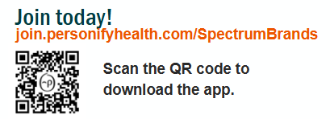
Personify Health – Wellness Program
Set your interests
Get personalized daily tips to help with healthy eating, getting active, reducing stress, sleeping well, and more!
Many ways to earn rewards - Earn up to $185 each year
Health Check: Short, confidential survey assess your health across several factors.
Healthy Habits: Bite-size ways to build a healthy routine.
Daily Cards: Tips to help you live well based on your interests.
Sleep Guide and Nutrition Guide
Medial Library: Interactive videos on a variety of topics.
Journeys: Digital coaching tool to make simple changes, one small step at a time.
Challenges: Personal & Group
Connect a device or app – Fitbit, MyFitnessPal, Google Fit, Apple Watch, and more
Up to $325 for a gym reimbursement once per calendar year
Notes:
Personify Health is our wellness program, and they help improve health and well-being through tools, resources, and social support.
You can take a health assessment and answer questions about your interests, and the system will show you relevant content based on those answers.
To earn points, you can track activity, healthy habits, and other metrics, like sleep and step counts. In the media library, you can find videos on a variety of topics as well as digital coaching tools that help you make simple changes to achieve your health goals.
You can connect a device or app like Fitbit or MyFitnessPal and get points for connecting them to the platform.
Through the points, you can earn up to $185 each year which can be redeemed as gift cards or items from the Personify Health store. Note that all redeemed points are taxable.
You can also submit proof of gym membership and get up to a $325 reimbursement once per calendar year.

